Slide 1


The Future of Green Terp
Team 57
Ryan Kim, Ryan Deppe, & Maria Lanasa

Slide 2
Table of Contents
INTRODUCTION
QUESTIONS
NOTES ABOUT DATA
What is Green Terp?
What are we looking for?
What do we need to know and assume?
ANALYSIS
CONCLUSION
What did we find?
What do we advise?

Slide 3
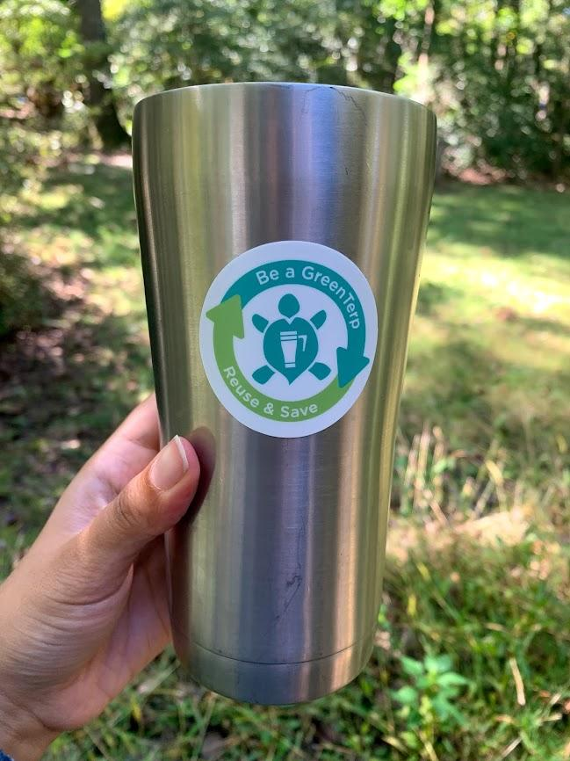
Introduction
Green Terp is a program in partnership with the Department of Resident Life & the Office of Sustainability to promote students to promote environmentally responsible choices.
They have requested for the Information Challenge 2024 to analyze their data set of students registering and certifying for their program.
Our team was tasked to analyze said data set to potentially advise Green Terp about their future processes.

Slide 4
Questions
Conversion Rates & Impact of ‘Red Flags’
How have the conversion rates of people certifying changed over the years? Are ‘red flags’ significant?
Housing & Certification
Trends over Time
Are people who live in certain environments more likely to certify?
How has things changed over the years? Can we predict anything?

Slide 5
Notes About Data - Focus
Taking a closer look at Data_Level3_GreenTerp.csv
Academic Year (AY) | The time when a form was submitted (2019-2023 excl. 2020)
Form Type | What kind of form is it? [Registration or Certification]
UniqueID | A student’s ID
Housing | Where is said student residing in?
Choices_(CHOICE_#_TYPE) | What choices would a student make to better the environment?

Slide 6
Notes About Data - Relevant Information
1
2
3
4
5
6
Data is collected by self-report
Some questions are required
Ideal to register first then certify
Yearly Certifications Required
Certification has its incentives ($3)
Form format might change

Slide 7
Notes About Data - Assumptions
1
2
3
4
Most information is reliable
Data is reliably cleaned
2022-2023 AY had fully concluded
‘Red flags’ and duplicates exist

Slide 8
Rates & Flags

Slide 9
Conversion Rates & Red Flags
Compiled using Python (Pandas & NumPy)
Without considering for ‘red flags’
Conversion rate of registered to certified is 46.502331778814124%
By year?
2018-2019 was 49.60691823899371% with 1262 certifications and 2544 registrations
2019-2020 was 44.52415112386418% with 931 certifications and 2091 registrations
2021-2022 was 50.93765838824126% with 1005 certifications and 1973 registrations
2022-2023 was 19.50718685831622% with 95 certifications and 487 registrations
Considering for ‘red flags’
Unique conversion rate from registering to certifying is 48.495200911013505%
More information is on the Jupyter Notebook in the Github repository

Slide 10
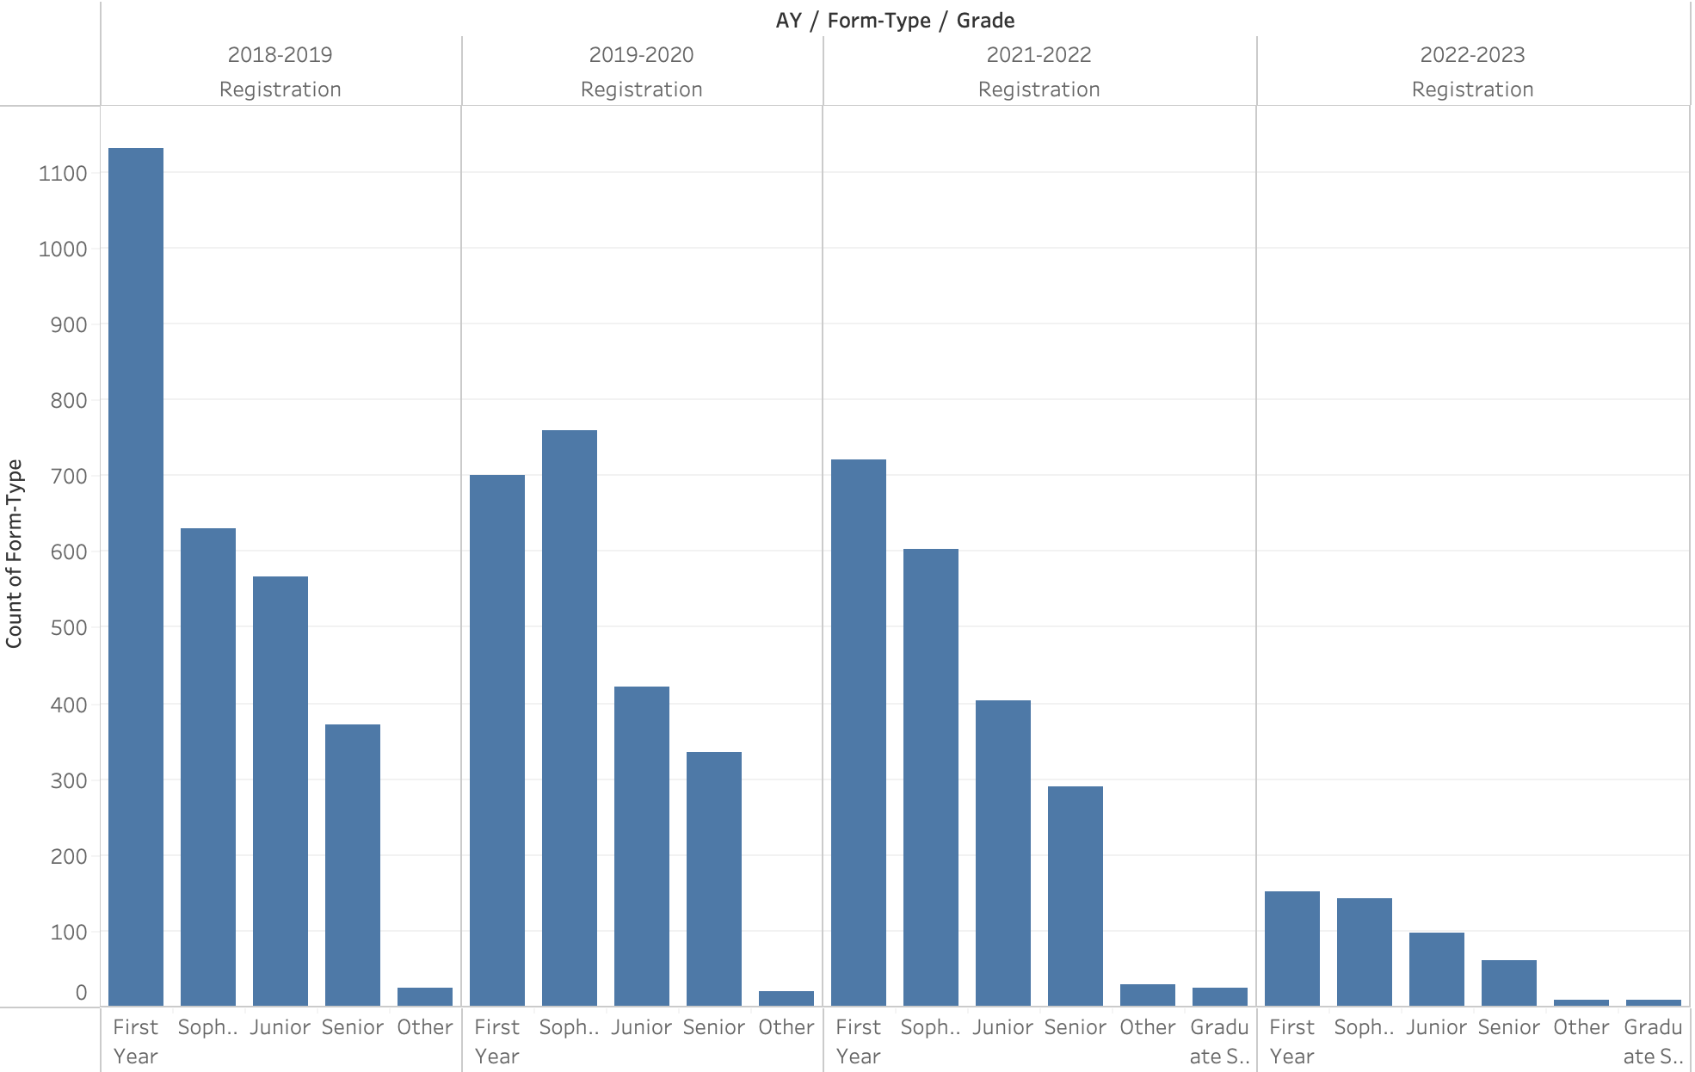
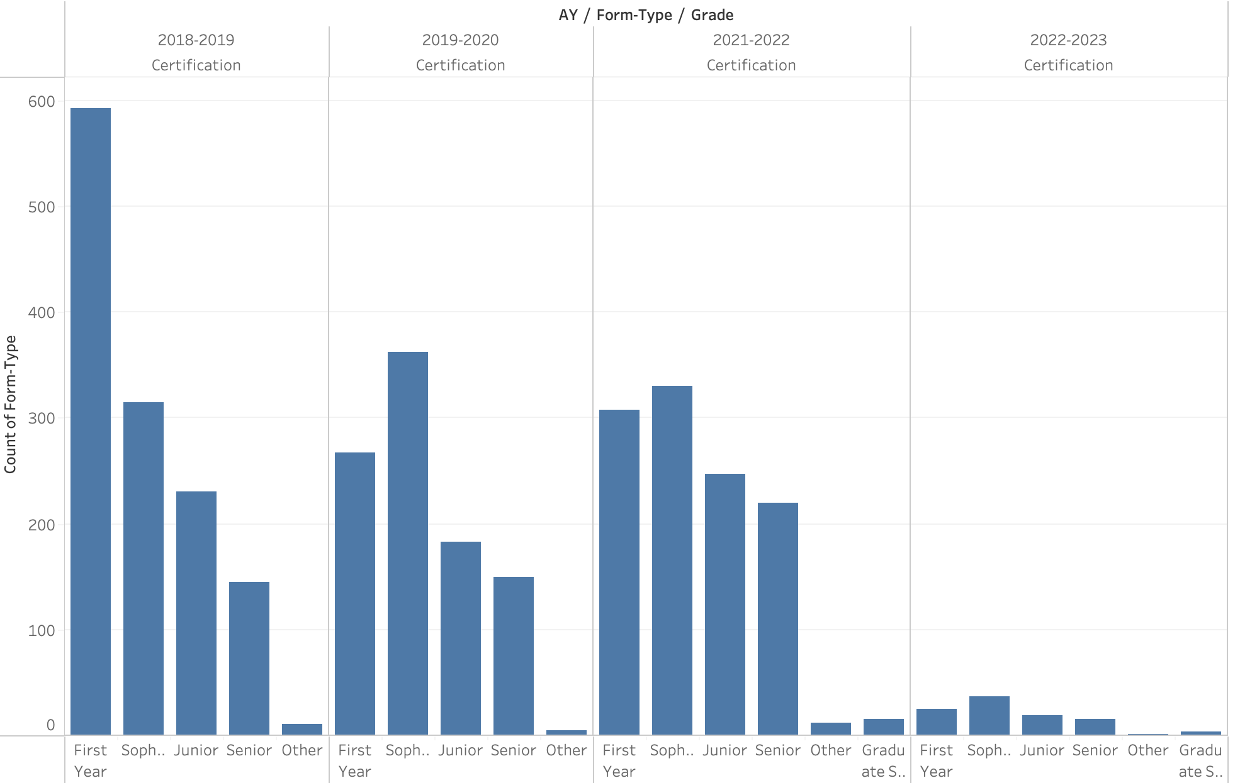
# of Certification & Registration by Year

Slide 11

5.75%
Of all forms were from ‘red flags’
That’s exactly 375 unique people out of 6522!

Slide 12
Housing

Slide 13
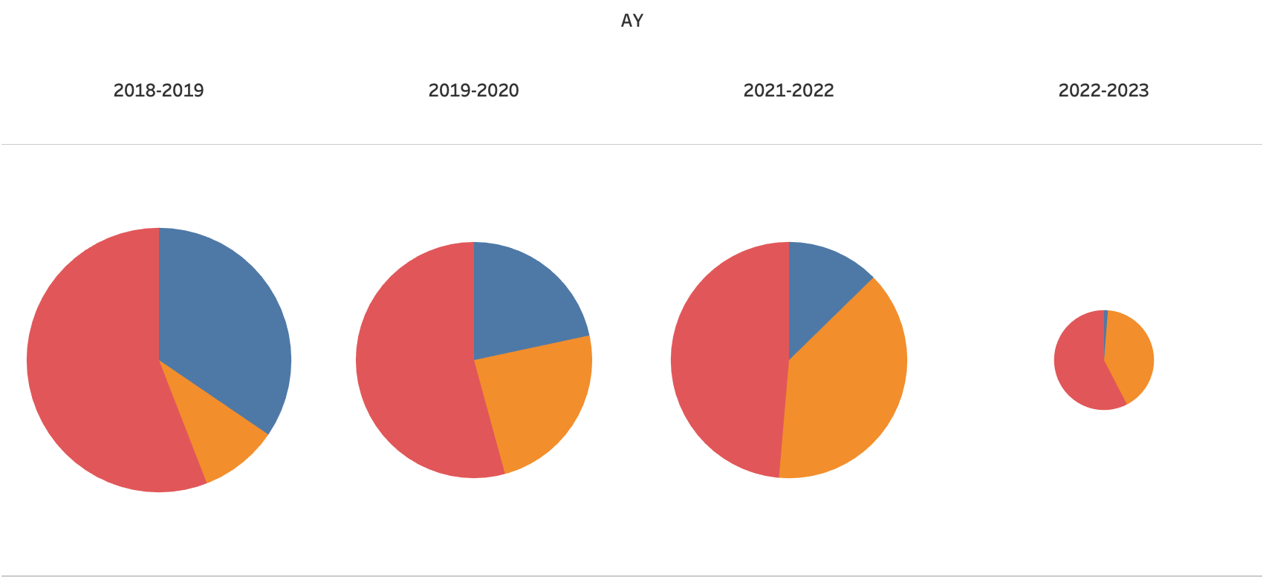
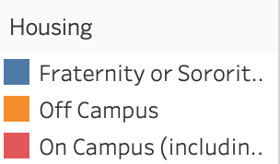
Responses based on housing per year

Slide 14
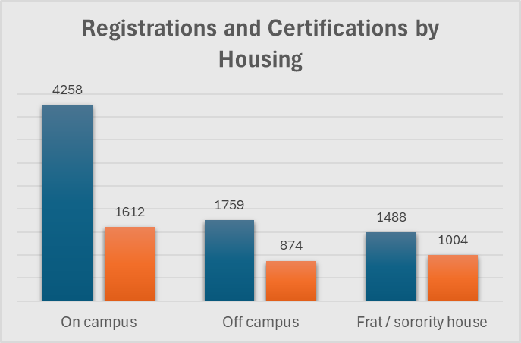
Registration and Certification by Housing
Previous slide showed responses based on housing
After breaking the data up by registration and certification, I compared rates for each housing type
Percent of registered students who certified :
37.9% of on campus students
49.7% of off campus students
67.5% of fraternity / sorority house students

Slide 15
Trends

Slide 16
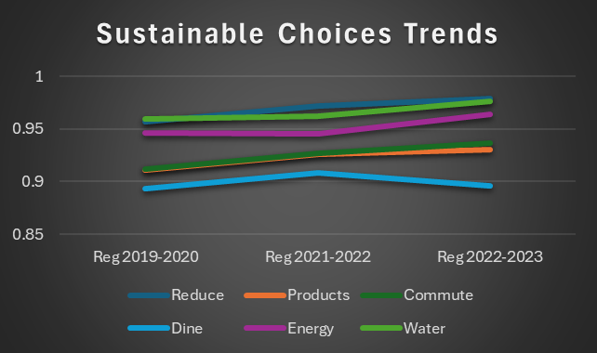
Annual Trends
Broke dataset up by registration and certification then also by year
Looking at the percentage of registered students who selected yes for each choice
Missing a lot of annual data - this was the only three year stretch available
Hard to draw significant conclusions, but we can see which actions are most popular

Slide 17
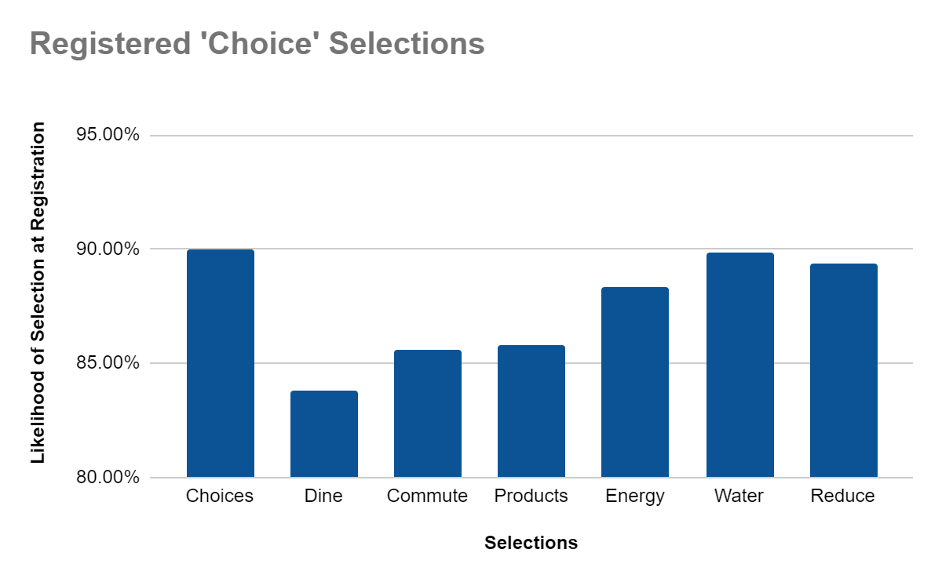
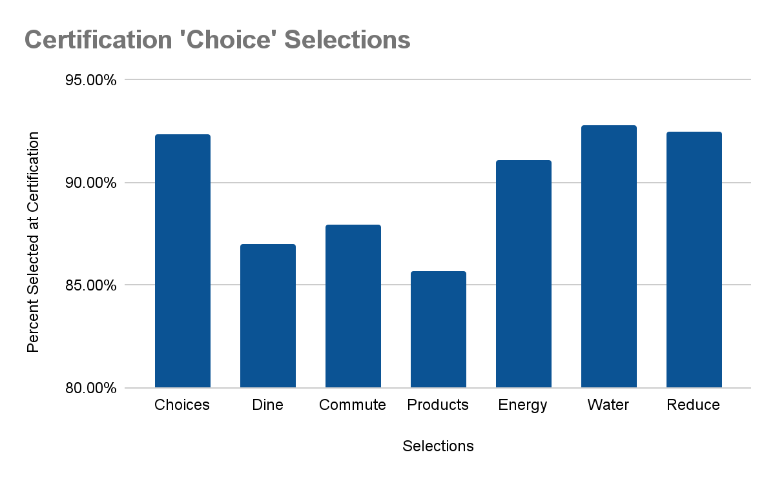
Comparing Student ‘Choices’
Selection
Of those who registered and of those who certified.
Utilizing data from the 2019-2020 academic year, we compare the student selection of choices at registration and at certification. The goal of this analysis is to understand if students are conducting the behaviors they selected at registration when they are certified.
Conclusions:
More ‘choices’ are selected at certification.
Student follow a similar pattern for the selection of ‘choices.’
Dine and commute are the most challenging selections for students.

Slide 18
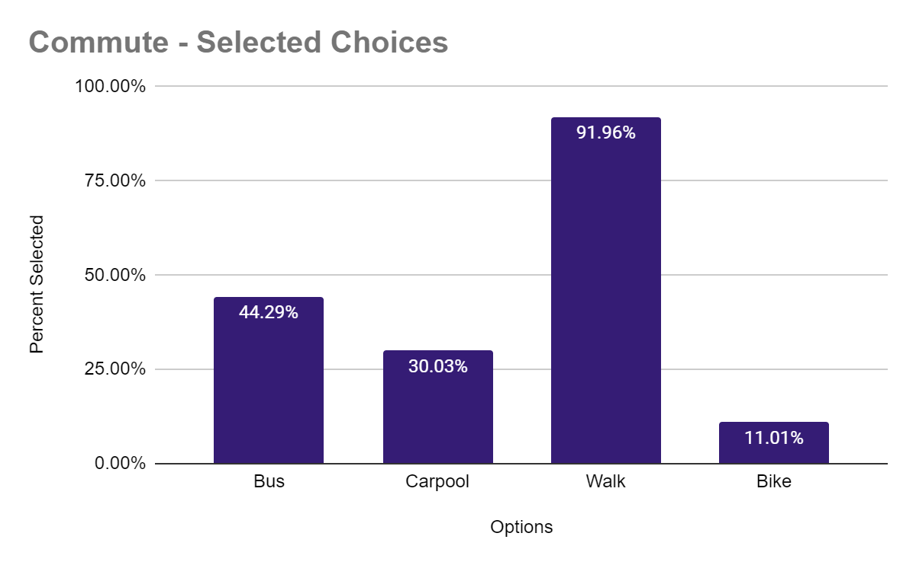
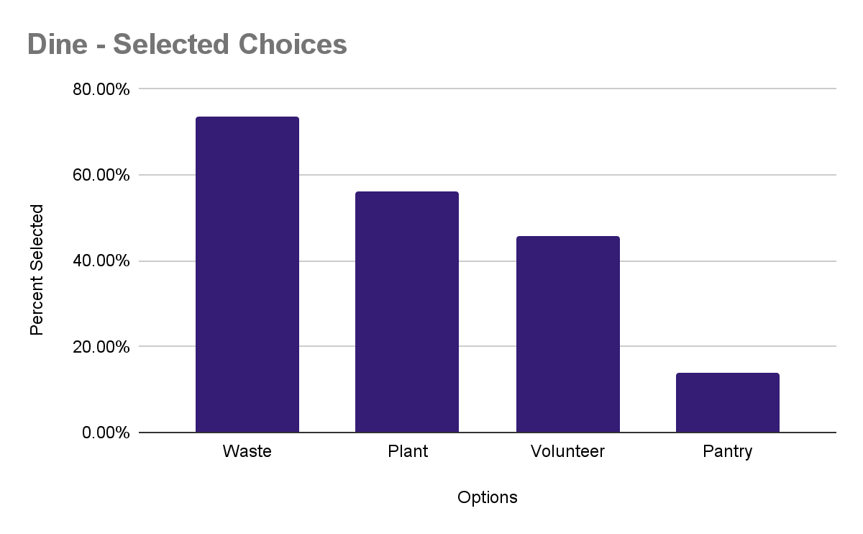
Understanding Student ‘Choices’
Selection
The most challenging behaviors for students - commute and dine.
Conclusions:
It is hard to change commuting patterns of those not in a walking vicinity.
Implementing more walking is the most popular commute lifestyle choice to be selected by students.
Implementing plant based meals and reducing waste are the easiest ways to students to change their dining habits.

Slide 19
Conclusion - Inferences from Data
Solution are based on what Green Terp really wants, we can only advise based on the data. [External factors aside]
If they want | We Advise (Based Off Data)
More registered members | Freshman centered events (slide 10) On-campus promotions (slide 14)
More legitimate certified members | Partnering with Greek Life (slide 14) Push for Freshman & Sophomore Certification (slide 10) Focus on certain choice selections for certifying (slide 18)
More awareness about the environment | Host events based on popular choices (slide 17 & 18) Focus engagement towards upperclassmen (slide 10)

Slide 20
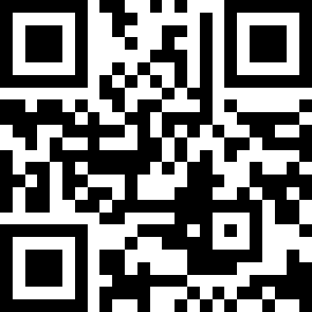
THANKS!
Please take a look the Github Repository for the behind-the-scenes technical + statistical work!
A full report in the format of a Jupyter Notebook will be published soon
https://tinyurl.com/2024team57

